Slide 1
Event Finder app
Engineering Bootcamp Final Project
February 23, 2018
Team EAA: Erin Richmond, Angela Barnes & Alok Khare
Notes:
Erin starts and others introduce selves

Slide 2
Agenda
Introductions
Tech learned / used
App description
Execution Process
Demo!
Backlog: mVP vs. phase 2 features
Q&A
Notes:
Angela

Slide 3
Tech Learned & Used
JavaScript
React
Redux
API calls
Notes:
Angela:
Using all these in our application.
We used React for the view layer of our application.
We used Redux to store state of our application.
We used 3 different API calls to retrieve the data being used in our application.

Slide 4
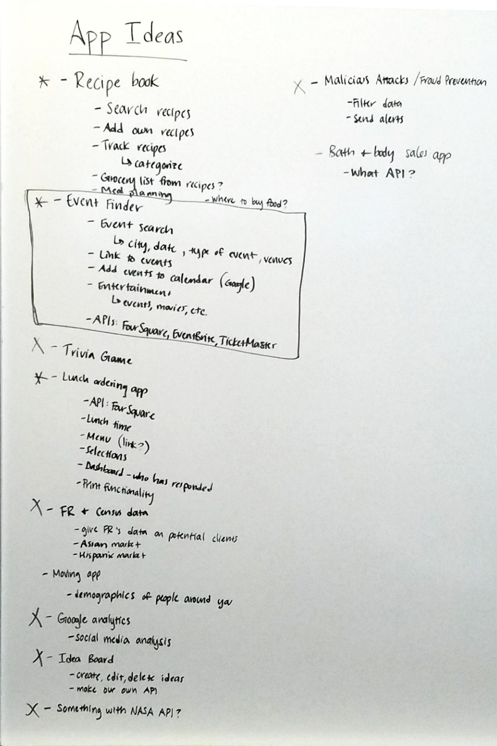
APP description
How we came up with the idea.
Notes:
Alok:
We brainstormed ideas and narrowed them by down by what fit our time constraints, was fun and used the technologies we learned in the bootcamp.
We decided to go with the Event Finder app to aggregate events from different sources near you or traveling to find events that might interest you in that location.

Slide 5
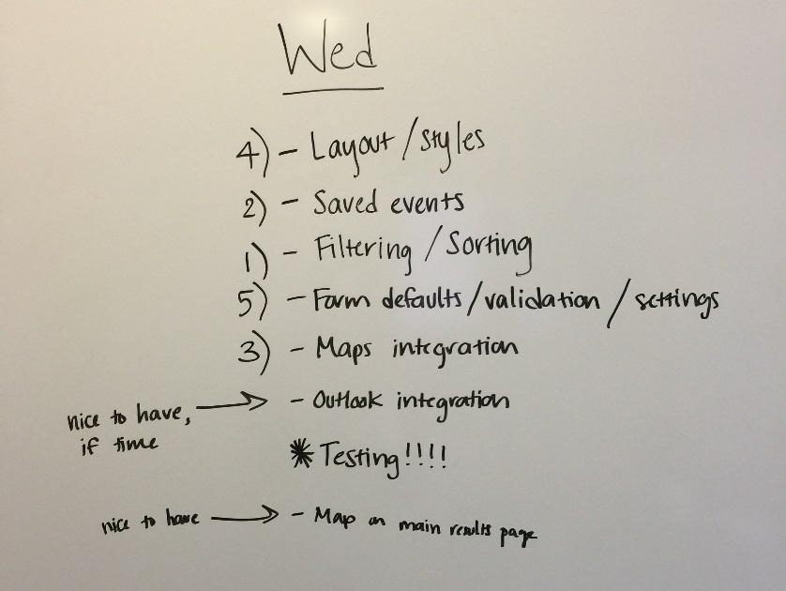
Execution process
    Loosely agile
    Features and stories
    Morning standup > refine backlog > determine priorities
    One day sprints
Notes:
Alok:
We worked in a loosely agile format.
We listed out features and broke them out into stories.
We planned each day noting what stories needed to be done that day.
At day end, we reviewed what had been accomplished.
The following day, we revised the backlog and planned for that day.

Slide 6
demo
Notes:
Erin

Slide 7

backlog
Pagination for return results = 10 results per page
Enabling calendar events for Outlook
Social media strip to “share with friends”
Additional images
Additional “niche” search venues
(e.g. birdwatching, chess tourney, etc.)
Notes:
Alok

Slide 8
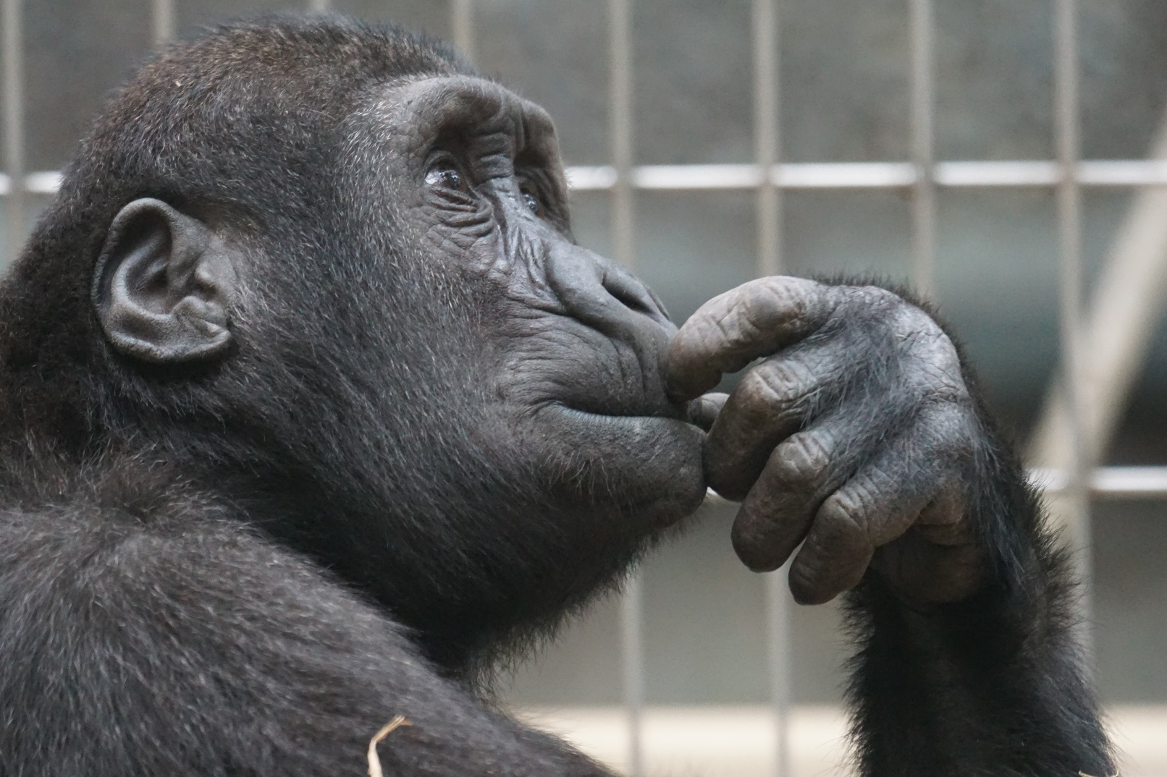
Q&A
What’s on your mind? Questions? Suggestions?
Notes:
Alok

